Slide 1


Spotify

Slide 2




Group 1
Welcome
Our Team:
About Us
Our Teams
Agenda
Our Services
Achievements
Our Goals
Gallery
Pricing
Contact Us
Louis Miranda
Sidd Kawatra
Bond Surber
Artist
Artist
Artist

Slide 3
k
Group 1
Welcome
Business Context
About Us
Our Teams
Agenda
Spotify is a digital music service that gives users access to millions of songs throughout their day-day lives. Our database is modeled after Spotify in order to provide insights into both users and artists within their music platforms and listening experiences
Our Goals:
Track user engagement
Curate playlists and mixes
Increase Artist popularity & audience reach
Optimize subscription plans and ads
Our Services
Achievements
Our Goals
Gallery
Pricing
Contact Us
Play

Slide 4
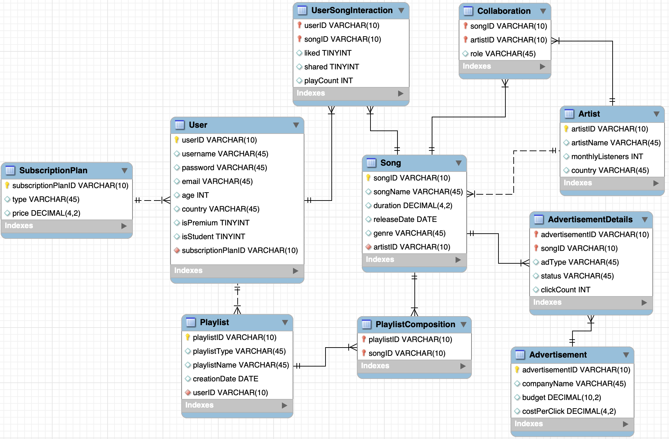

Slide 6
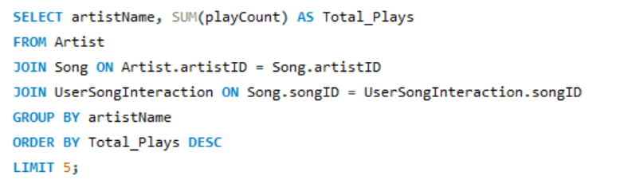
Group 1
Query #1
List the top 5 artists with the most song plays across all users.

Slide 7
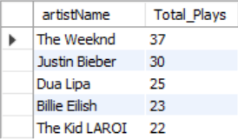
Group 1
Query #1
Benefits:
Identifies which artists are driving the most engagement, helping with future collaborations or exclusive releases.

Slide 8
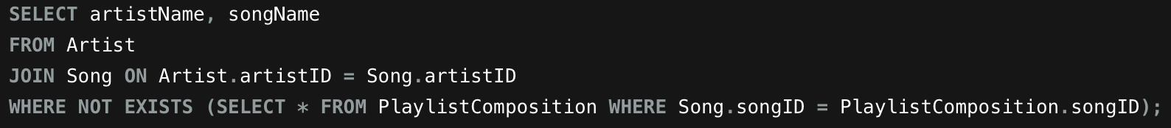
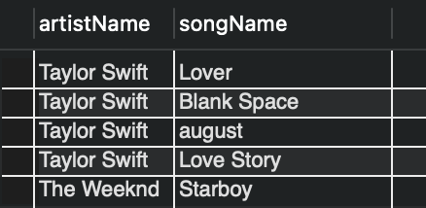
Group 1
Query #2
List the name of artists and their songs that are not currently in any playlists
Notes:
This SQL query retrieves the names of artists & their songs from the Artist and Song tables. It uses a JOIN clause to combine data from these two tables and applies a WHERE clause with a subquery to filter the results.
Starting with the SELECT Clause: we have
SELECT artistName, songName: This selects two columns for the output: the name of the artist (artistName) and the name of the song (songName).
Next for the FROM Clause:
FROM Artist: This specifies the Artist table as the source of the query.
Then we have a JOIN Clause:
JOIN Song ON Artist.artistID = Song.artistID:
This JOIN connects the Artist table to the Song table by matching the artistID column in both tables. Basically, this ensures that each artist is linked with their corresponding songs based on their unique artistID.
Finally we have a WHERE Clause with a Subquery:
WHERE NOT EXISTS: This filters the results using a subquery. The NOT EXISTS clause checks whether there are any entries in the PlaylistComposition table for the current song being processed.
For the Subquery: This subquery selects records from the PlaylistComposition table where the songID from the Song table matches the songID in PlaylistComposition.
If no Primary Key-Foreign Key match exists (i.e., the song is not part of any playlist), then that song will be outputted
In the provided table (under the query), the result lists songs by Taylor Swift and The Weeknd that are not currently part of any playlist in the PlaylistComposition table. For example, songs like "Blank Space," and "Starboy" are not in any playlist, and hence they are shown in the result.

Slide 9
Group 1
Query #2
Benefits:
Identifies songs that aren’t included in playlists, which can help optimize playlist curation or potentially increase visibility of unpopular song
Notes:
Some of the Benefits yielded from this Query include:
Identifying songs that aren't included in playlists:
This
Increases visibility: These songs might be overlooked by users, and including them in playlists could increase their exposure, leading to more streams.
Improves curation: Playlists are essential for user engagement. Ensuring a diverse and complete selection of songs can enhance the user experience by bringing attention to tracks that are not yet included.
Can increase the visibility of less popular songs:
Songs that do not appear in any playlist could be less popular or new releases. By recognizing these songs, playlist curators can decide to feature them more prominently, helping increase their exposure and popularity.
Overall, This query provides a practical tool for improving playlist curation, allowing music services or curators to ensure that all songs get the visibility they deserve, and helping optimize user engagement and experience

Slide 10
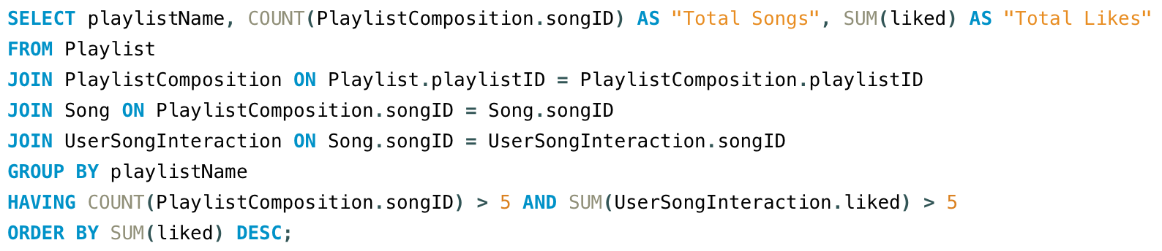
Group 1
Query #3
List playlists with greater than 5 songs and and a total number of likes across all songs greater than 5

Slide 11
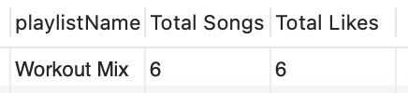
Group 1
Query #3
Benefits:
Helps identify large playlists that have received significant engagement. These playlists can be used to focus the advertisements on biggest playlists and can be used as templates for creating other successful playlists

Slide 12


Thank You
Despacito
Luis Fonsi, Daddy Yankee
0:23
-3:25

Slide 13
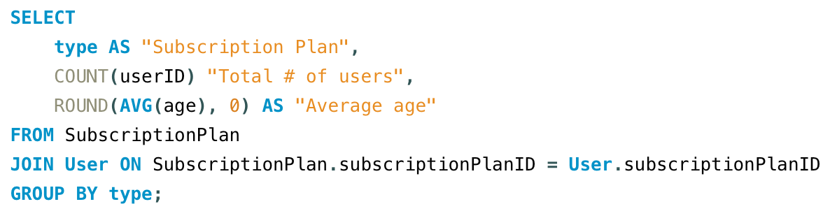
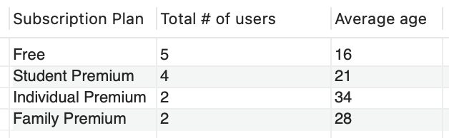
Group 10
Query #1
List the total number of users and their average age for each subscription plan

Slide 14
Group 10
Query #1
Benefits:
Provides demographic insights
↳ Tailor subscription plans to different age groups
Optimize advertisements

